Slide 1



amazon dash bord
View in Power BI
Last data refresh:
3/15/2024 10:31:52 AM UTC
Downloaded at:
3/20/2024 8:12:22 AM UTC

Slide 2
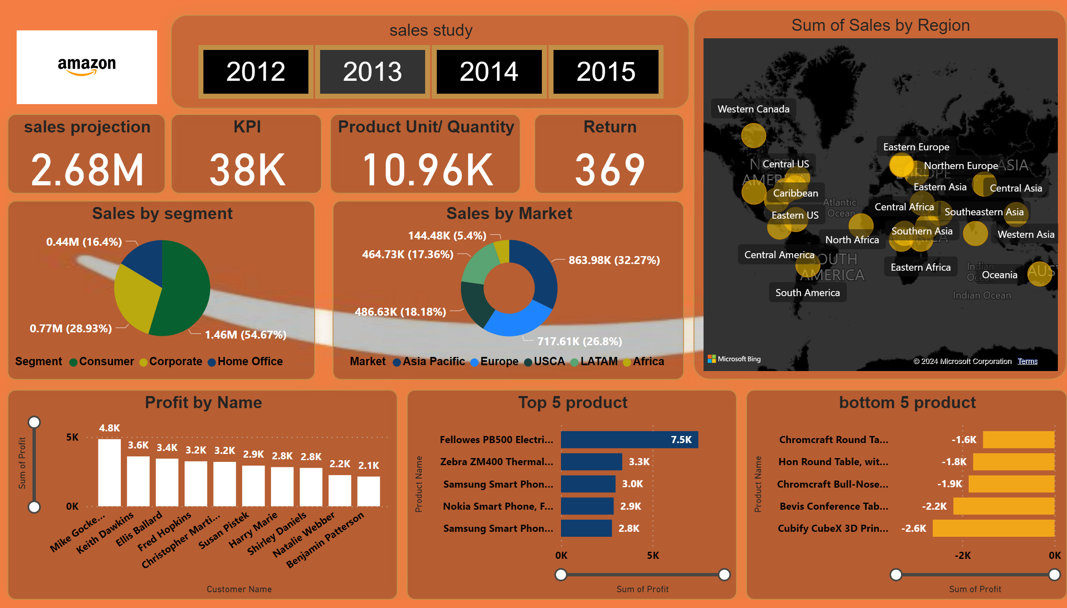
amazon dash board
Notes:
image
No alt text provided
map
No alt text provided
bottom 5 product
No alt text provided
Top 5 product
No alt text provided
Profit by Name
No alt text provided
Sales by Market
No alt text provided
Sales by segment
No alt text provided
sales projection
No alt text provided
KPI
No alt text provided
Product Unit/ Quantity
No alt text provided
Return
No alt text provided
sales study
No alt text provided

